Slide 1
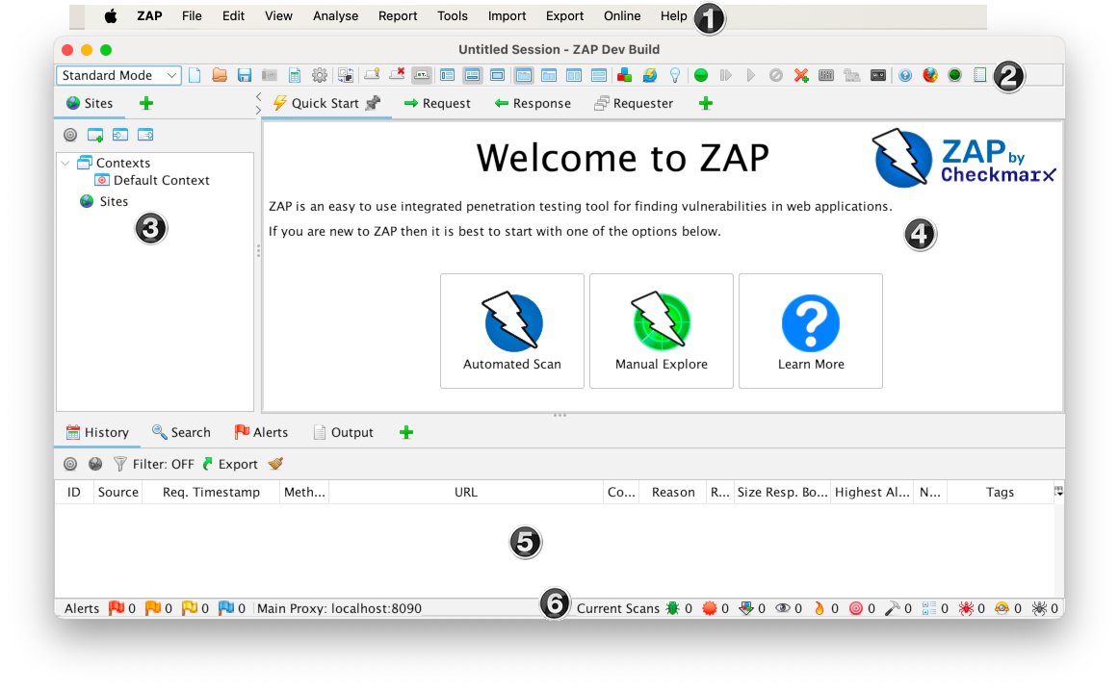
Automated Vulnerability Scanning with OWASP ZAP
OWASP ZAP (Zed Attack Proxy) is a free, open-source security tool used to find vulnerabilities in web applications, and detect SQL injections,XSS and misconfigurations.

Slide 2
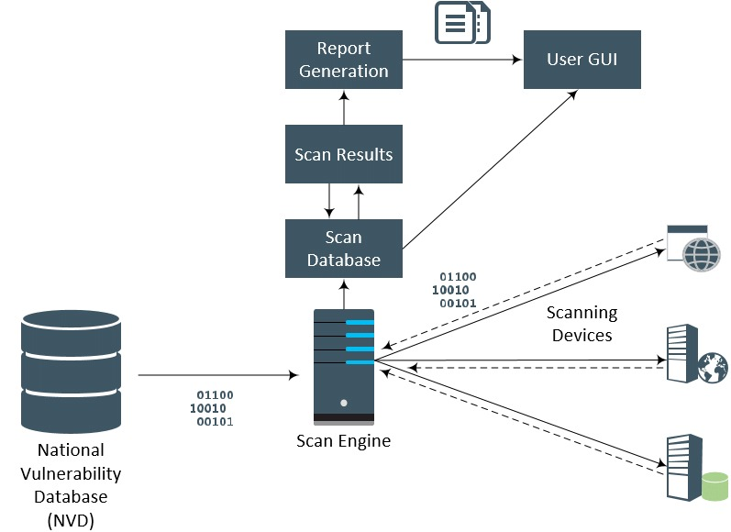
🔍What Is Automated Scanning?
Automated scanning uses tools to quickly find:
Open endpoints
Misconfigurations
Common web vulnerabilities
Attackers use this to understand a target fast.

Slide 3
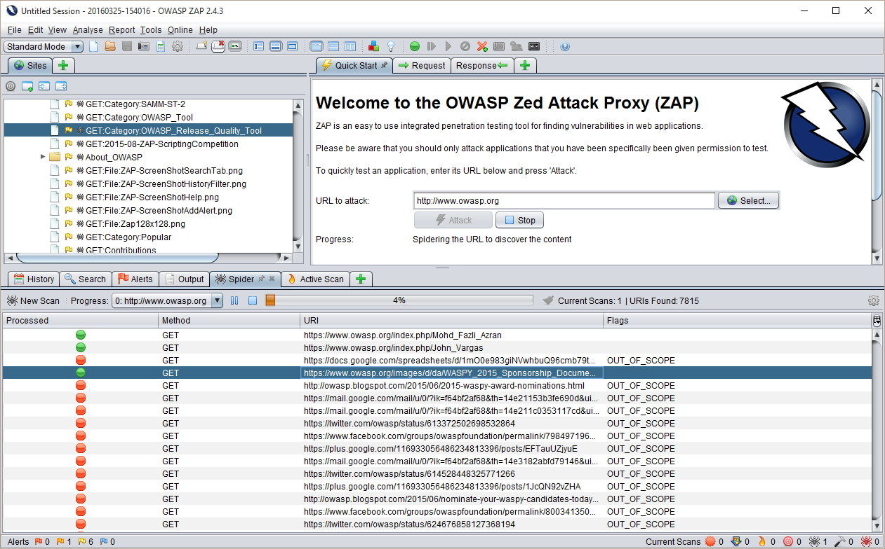
How Attackers Map Targets Using Automated Scanning
OWASP ZAP lets defenders use the same advantage, ethically and legally.

Slide 4
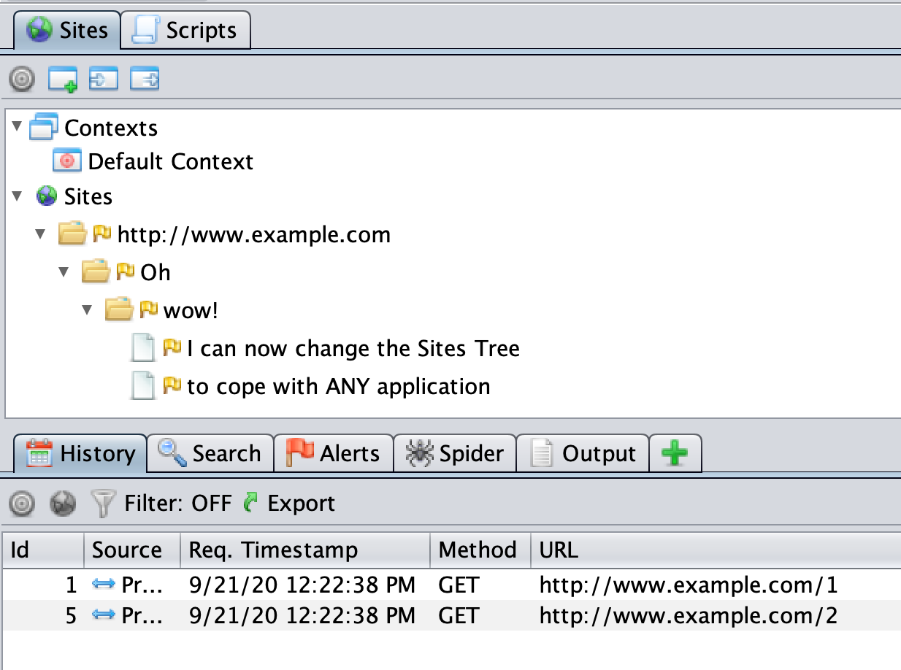
What Attackers See During Automated Scanning
When attackers run automated tools like OWASP ZAP, they don’t see your website the way users do. They see structure, weaknesses, and opportunities.
🛡️Application Structure
Attackers quickly discover:
All reachable pages and endpoints
Hidden URLs not linked in the UI
Parameters used in requests
This creates a full map of the application

Slide 5
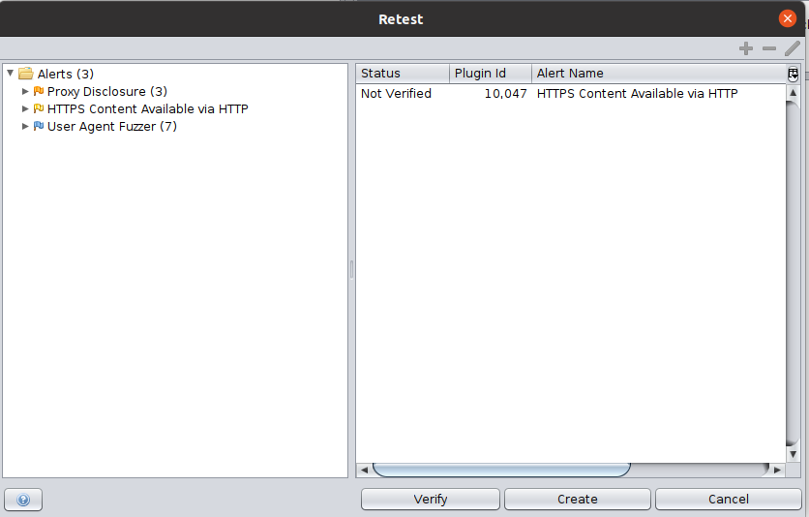
🚪Entry Points
They identify where data enters the system:
Login forms
Search fields
URL parameters
API requests
Each input becomes a possible attack path.

Slide 6
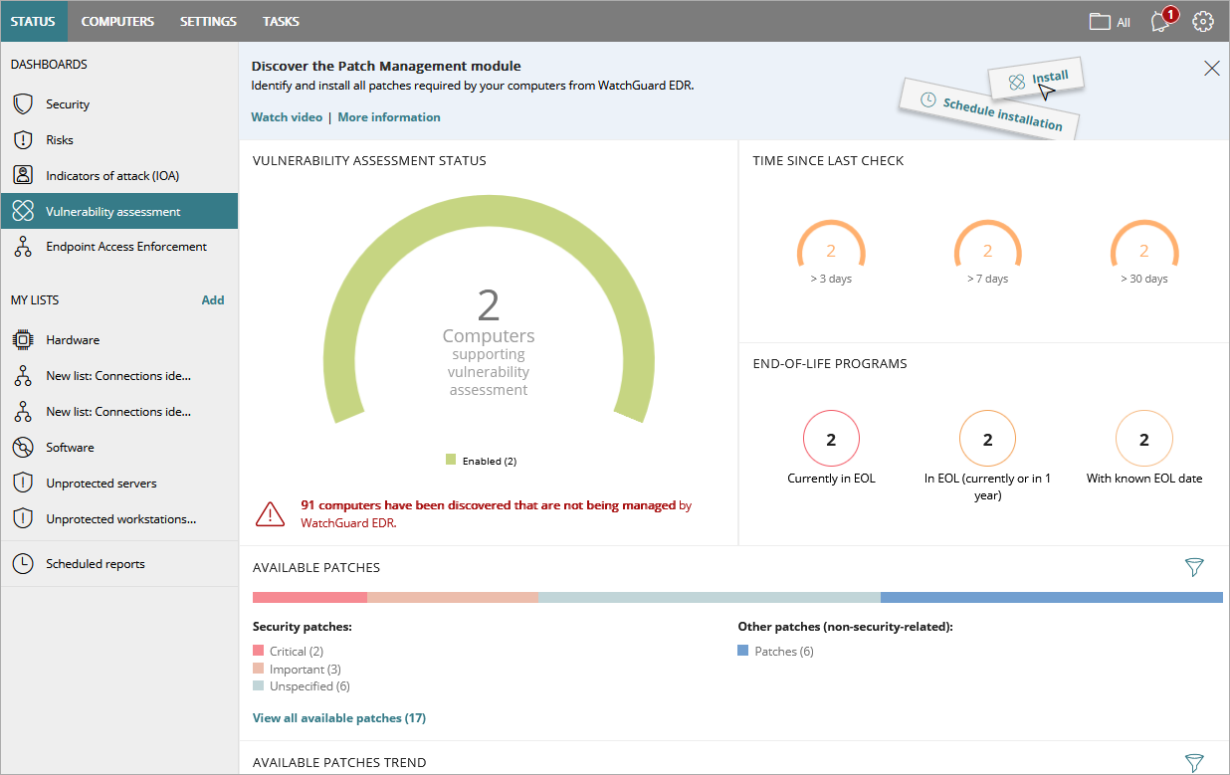
🧪Vulnerabilities
Automated scans highlight:
SQL Injection
Cross-Site Scripting (XSS)
Missing security headers
Authentication flaws
These are ranked by severity to prioritize attacks.

Slide 7
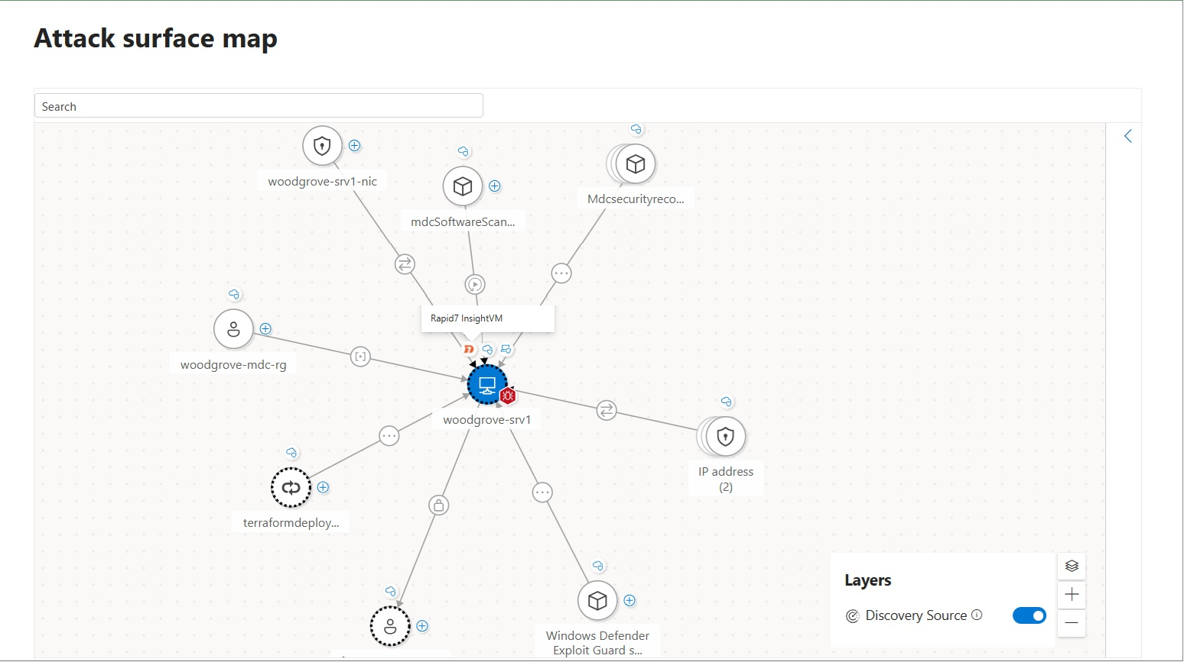
🗺️Attack Surface
Attackers see:
How systems connect
Which areas are exposed
Weak links between components
This helps them plan the easiest path in.

